Slide 1
Data Warehousing: Basic Concepts
Hannah Andrews and Angela Hughes

Slide 2
“A data warehouse is a subject-oriented, integrated, time-variant, and nonvolatile collection of data in support of management’s decision-making process.”—W. H. Inmon
Subject-Oriented
Integrated
Time-variant
Nonvolatile
This Photo by Unknown Author is licensed under CC BY
Notes:
“First, let’s define data warehouse. A data warehouse is a copy of transaction data specifically structured for query and analysis. Data warehouses are designed with the goal of aggregating and summarizing data from various sources across an entire organization to be used for strategic decision making. When defining data warehouses, they are often compared to operational databases, which are store short term transaction data used for day to day operations. I’ll refer to the differences between a data warehouse and operational database as we define data warehouse.
Bill Inmon, the “father of data warehousing” defines a data warehouse as a subject-oriented, integrated, time-variant, and nonvolatile collection of data in support of management’s decision-making. While data warehouses are defined in many different ways, these four characteristics- subject-oriented, integrated, time-variant, and nonvolatile- are the most common ways of defining them.”
Enterprise resource planning (ERP) is the integrated management of main business processes, often in real time and mediated by software and technology.
ETL stands for Extract, Transform and Load
Defined in many different ways, but not rigorously.
A decision support database that is maintained separately from the organization’s operational database
Support information processing by providing a solid platform of consolidated, historical data for analysis.
“A data warehouse is a subject-oriented, integrated, time-variant, and nonvolatile collection of data in support of management’s decision-making process.”—W. H. Inmon
Data warehousing:
The process of constructing and using data warehouses

Slide 3
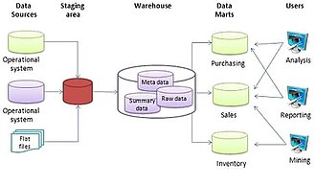
Data warehouses are organized around major subjects, such as customer, product, sales, etc.
Subject-oriented
This Photo by Unknown Author is licensed under CC BY-SA
Notes:
“First, data warehouses are subject-oriented, meaning they are organized around major subjects, such as customer product or sales. Data warehouses are focused on the modeling and analysis of data for decision makers, as opposed to daily operations or transaction processing. Organizing data around specific subjects provides a simple and concise view around particular subject issues by excluding data that are not useful in the decision support process.”
Organized around major subjects, such as customer, product, sales
Focusing on the modeling and analysis of data for decision makers, not on daily operations or transaction processing
Provide a simple and concise view around particular subject issues by excluding data that are not useful in the decision support process

Slide 4
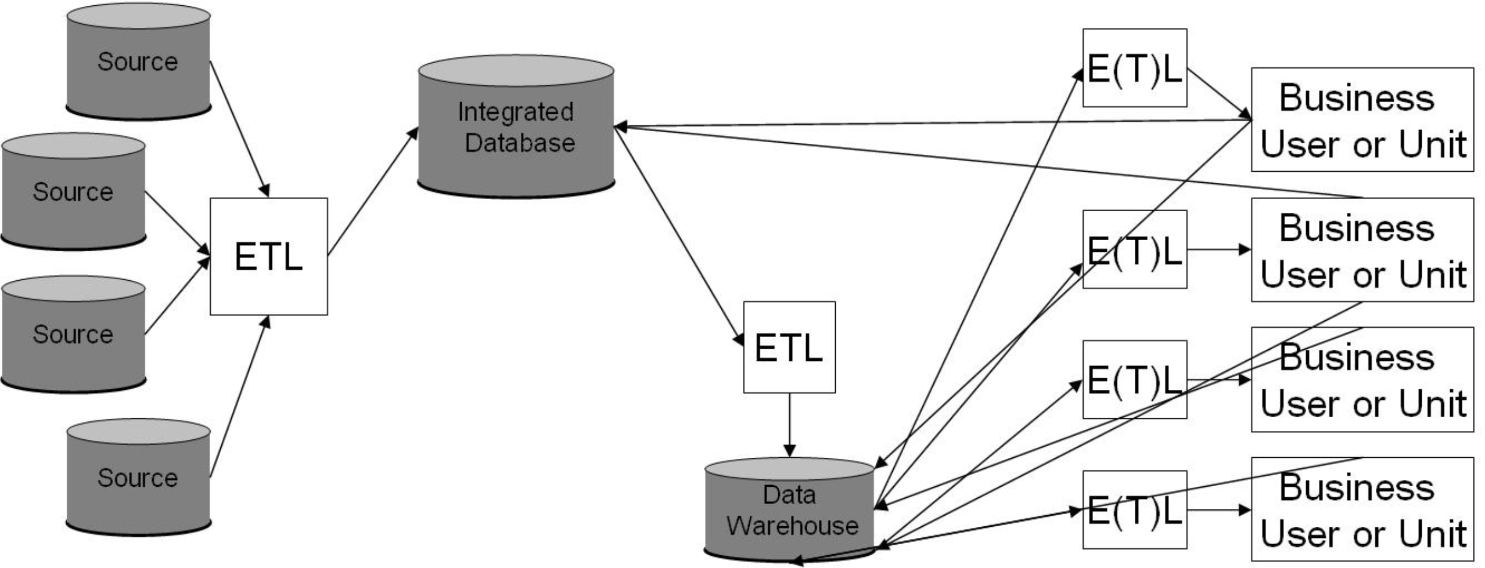
Data warehouses are constructed by integrating data from multiple heterogenous data sources.
Integrated
This Photo by Unknown Author is licensed under CC BY-SA
Notes:
“Second, data warehouses are integrated, meaning data warehouses are constructed by integrating data from multiple heterogenous data sources, such as relational databases or on-line transaction records. Operational databases, which store current transaction data, provide data for the data warehouse. There are many operational databases within an organization, focused on various aspects of day to day operations. ETL on the figure here stands for extract, transform, and load. Data is extracted from multiple operational databases across an organization, transformed into the same format for consistency (for example, consistency in naming conventions), and then loaded into the data warehouse.”
Constructed by integrating multiple, heterogeneous data sources
relational databases, flat files, on-line transaction records
Data cleaning and data integration techniques are applied.
Ensure consistency in naming conventions, encoding structures, attribute measures, etc. among different data sources
E.g., Hotel price: currency, tax, breakfast covered, etc.
When data is moved to the warehouse, it is converted.

Slide 5
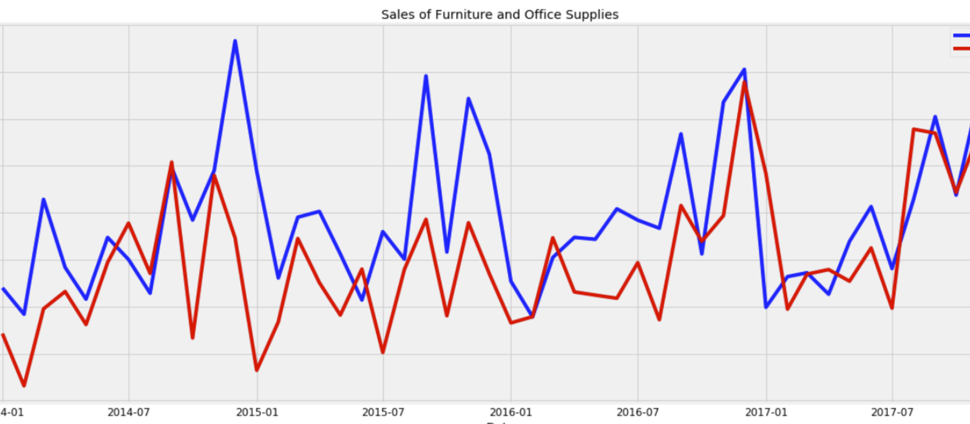
Data warehouses store historical data.
Time variant
Notes:
“Third, data warehouses are time variant, meaning they store historical data. Operational databases, by contrast, store only current data. Data warehouses can provide information from a historical perspective, for example comparing sales across many years. This again is key to the data warehouses’ purpose of aiding in strategic decision making.”
The time horizon for the data warehouse is significantly longer than that of operational systems
Operational database: current value data
Data warehouse data: provide information from a historical perspective (e.g., past 5-10 years)
Every key structure in the data warehouse
Contains an element of time, explicitly or implicitly
But the key of operational data may or may not contain “time element”
https://towardsdatascience.com/an-end-to-end-project-on-time-series-analysis-and-forecasting-with-python-4835e6bf050b

Slide 6
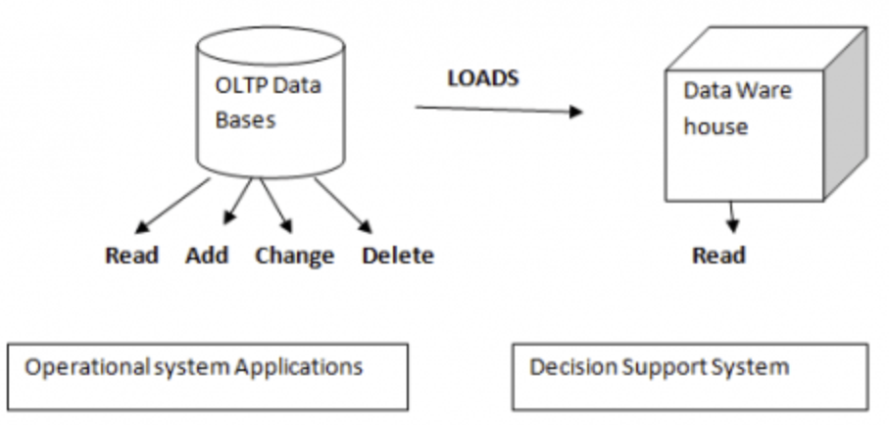
When new data is added to the data warehouse, previous data is not erased.
Non-volatile
Notes:
“Finally, data warehouses are non-volatile, meaning that when new data is added to the data warehouse, previous data is not erased. This is again in contrast to operational systems, which are constantly updating and deleting data. You can see here that more operations are performed on the operational or OLTP databases compared to the data warehouse. Data is read, added to, changed and deleted. The data warehouse requires only two operations: initial loading and the accessing of reading of data.”
A physically separate store of data transformed from the operational environment
Operational update of data does not occur in the data warehouse environment
Does not require transaction processing, recovery, and concurrency control mechanisms
Requires only two operations in data accessing:
initial loading of data and access of data

Slide 7
Online analytical processing (OLAP) is used for analytics, while online transaction processing (OLTP) is used for transactions.
Notes:
“So we have operational databases and data warehouses. Online analytical processing (OLAP) is used for analytics on data warehouse data, whereas online transaction processing (OLTP) is used for processing transactions within operational databases. One of the main differences between these is the user. OLTP may used by many users, including clerks and IT professionals to view typically single transactions, whereas far fewer people use OLPA, and the ones that do are typically decision makers within an organization. The primary function of OLTP is to support day to day operations, whereas the primary function of OLAP is to support decision making. OLTP is designed to be application-oriented, whereas OLAP is designed to be subject-oriented. OLTP works with current data, whereas OLAP works with historical data. OLTP may read and write over data, whereas OLAP scans data. Finally, there are also differences in database size and the complexity, with data warehouses of course being larger and OLAP being more complex.
https://www.datawarehouse4u.info/OLTP-vs-OLAP.html
“An operational database undergoes frequent changes on a daily basis on account of the transactions that take place. Suppose a business executive wants to analyze previous feedback on any data such as a product, a supplier, or any consumer data, then the executive will have no data available to analyze because the previous data has been updated due to transactions.
A data warehouses provides us generalized and consolidated data in multidimensional view. Along with generalized and consolidated view of data, a data warehouses also provides us Online Analytical Processing (OLAP) tools. These tools help us in interactive and effective analysis of data in a multidimensional space. This analysis results in data generalization and data mining. https://www.tutorialspoint.com/dwh/dwh_overview.htm“
“Online analytical processing is used to process data from data warehouses, whereas online transaction processing is used for processing transaction data from the operational databases that warehouse data is sourced from.

Slide 8
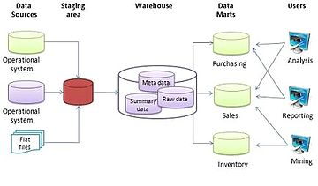
A multi-tiered architecture allows for higher performance and simplicity.
This Photo by Unknown Author is licensed under CC BY-SA
This Photo by Unknown Author is licensed under CC BY-SA
Notes:
“Data warehouses typically employ a multi-tiered architecture which allows for higher performance and greater simplicity. This is a three tier system. In the first tier, we have the separate operational databases or database management systems. These are loaded into a staging area for integrated- extraction, transformation, and then loading into the warehouse, tier two. By keeping the operational databases and the warehouse separate, each may more efficiently perform their own tasks- OLTP within operational databases, and OLAP within the data warehouse. In the middle tier, the warehouse, we have three types of data. Metadata (data about the data), raw data (from the operational databases), and summary data (aggregations from the raw data). In the third or top tier, we have the front-end client layer, which contains query and reporting tools, analysis tools, and/or data mining tools.”
High performance for both systems
DBMS— tuned for OLTP: access methods, indexing, concurrency control, recovery
Warehouse—tuned for OLAP: complex OLAP queries, multidimensional view, consolidation
Different functions and different data:
missing data: Decision support requires historical data which operational DBs do not typically maintain
data consolidation: DS requires consolidation (aggregation, summarization) of data from heterogeneous sources
data quality: different sources typically use inconsistent data representations, codes and formats which have to be reconciled
Note: There are more and more systems which perform OLAP analysis directly on relational databases
Bottom tier: warehouse database server; almost always a relational database system. Back end tools perform extraction, cleaning, and transformation, load and refresh functions to update the data warehouse.
Gateways: application program interface used to extract data
This tier contains the metadata repository
Middle tier: OLAP server
Top tier: front-end client layer; contains query and reporting tools, analysis tools, and/or data mining tools.

